Slide 1
Determination of genetic network from time series gene expression data-a modified approach
Supervised By:
Tareque Mohmud Chowdhury
Assistant Professor
Department of Computer Science and Engineering
Islamic University of Technology
Presented By:
Hasan Md Tusfiqur Alam – 104409
Nayreet Islam Rupak -104436

Slide 2
Contents
Introduction
Thesis Objective
Motivation
Related Works
Problem Identification
Proposed Method
Results and Analysis
Discussion
References

Slide 3
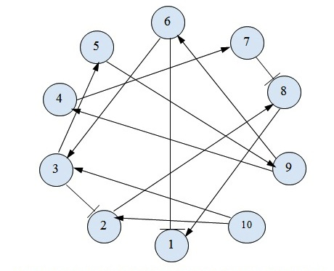
Introduction
Gene Regulatory Network(GRN) is a collection of DNA segments in a cell which interact with each other indirectly thereby governing the expression levels of mRNA and proteins
In gene regulatory network, genes or proteins or metabolites are expressed as nodes and interaction between them is expressed as edges.
Proteins produced by one gene park themselves in the promoter of other genes and controls the activity of others gene.

Slide 4
Thesis Objective:
Developing an optimal data reduction method for time series data.
Finding the influencing set of genes for the expression
Of each gene.
Determining the most contributing genes for the growth of the organism.
Formation of gene regulatory network using contributing genes.
Performing evaluation of genetic Network using Roc curve.

Slide 5
Motivation:
Genetic networks provide knowledge about functional pathway in a given cell.
This represents processes such as metabolism, gene regulation, transport, and signal transduction.
For any disorder in genetic network may lead to diseases or behavioral disorder in the living species.
The development of cancer in a cell can be tracked.
Paves the way for ‘drug designing’ by finding responsible protein.
Hence, being able to determine regulatory network is a problem of paramount importance.

Slide 6
Related works:
Gene Regulatory Network formation consists of two parts: 1.Data Reduction
2.Network Formation
Data Reduction Methods
Network Formation
Boolean Networks
Bayesian Networks
Artificial Neural Networks
Fidelity matrix approach
Clustering using similarity distance function

Slide 7
Problem identification:
In Fidelity matrix approach Use of undefined arbitrary threshold value.
In the very early phase of data reduction process a large number of data are discarded & the effect of those genes on the entire network is not studied.
Thus, it may result in considerable deviation from the original and actual genetic network.
During Network formation relation among the genes for all time states are not determined using ANN.
To find the full GRN other relations are to be determined.

Slide 8
Proposed method:
Work flow of the method:
Preprocessing
Data Reduction
Formation of sets containing gene interaction.
Selecting most influential genes
Determining GRN from influential genes

Slide 9
Proposed method
1. Preprocessing:
Representation of Microarray data:
As sample dataset, gene expression value for Burkholderia pseudomalli were taken. Format :matrix M[5289,47] ; each row and column represents a gene and a time instant respectively.
Removal of Redundant Data:
The redundant NAN (not a number) & negative expression values for any gene at certain
matrix position in matrix M are made zero.

Slide 10
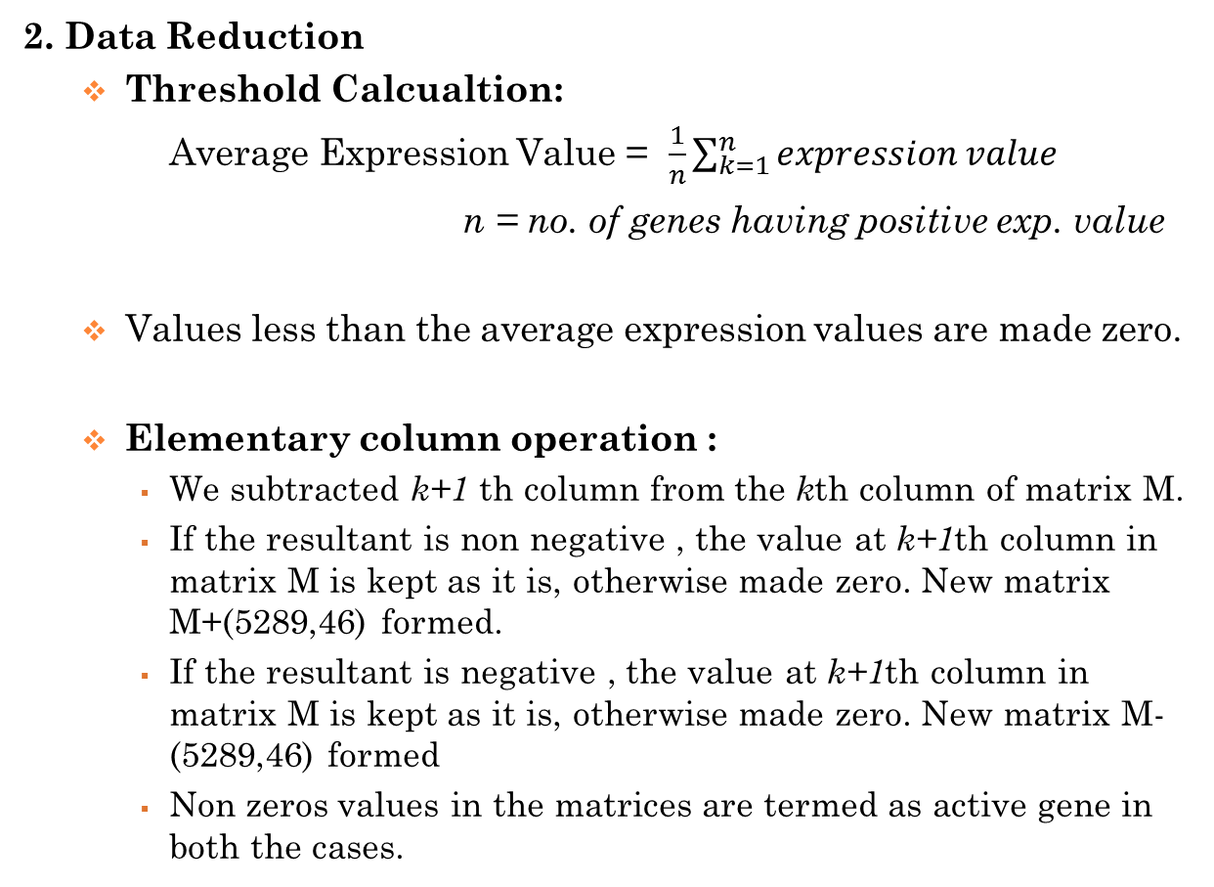
Proposed method:
2. Data Reduction
Threshold Calcualtion:
Average Expression Value = $\frac{1}{n}\sum_{k=1}^{n}{expression value}$
n = no. of genes having positive exp. value
Values less than the average expression values are made zero.
Elementary column operation :
We subtracted k+1 th column from the kth column of matrix M.
If the resultant is non negative , the value at k+1th column in matrix M is kept as it is, otherwise made zero. New matrix M+(5289,46) formed.
If the resultant is negative , the value at k+1th column in matrix M is kept as it is, otherwise made zero. New matrix M- (5289,46) formed
Non zeros values in the matrices are termed as active gene in both the cases.

Slide 11
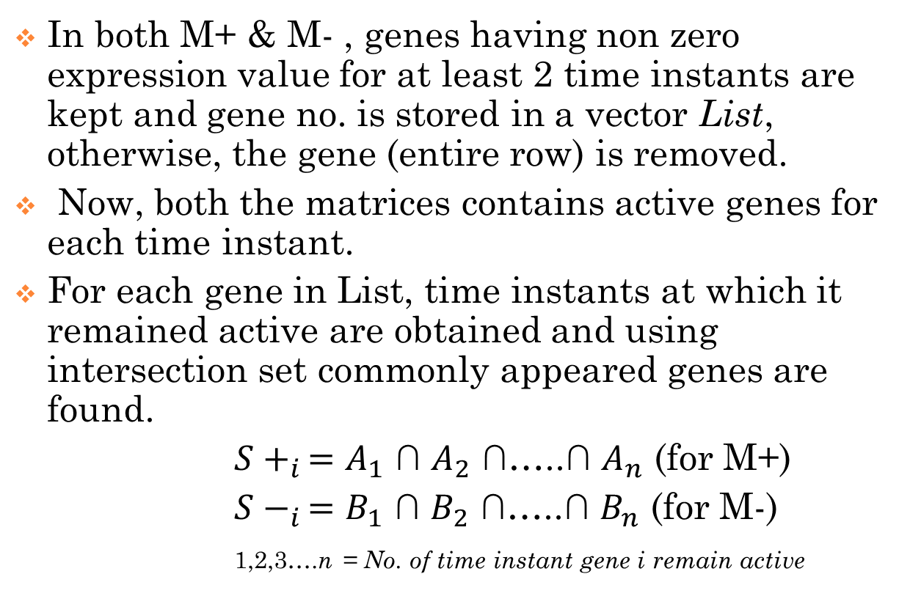
Proposed method:
In both M+ & M- , genes having non zero expression value for at least 2 time instants are kept and gene no. is stored in a vector List, otherwise, the gene (entire row) is removed.
Now, both the matrices contains active genes for each time instant.
For each gene in List, time instants at which it remained active are obtained and using intersection set commonly appeared genes are found.
${S+}_{i }=$ $A_{1}$ ∩ $A_{2}$ ∩…..∩ $A_{n}$ (for M+)
${S−}_{i }=$ $B_{1}$ ∩ $B_{2}$ ∩…..∩ $B_{n}$ (for M-)
1,2,3….n = No. of time instant gene i remain active

Slide 12
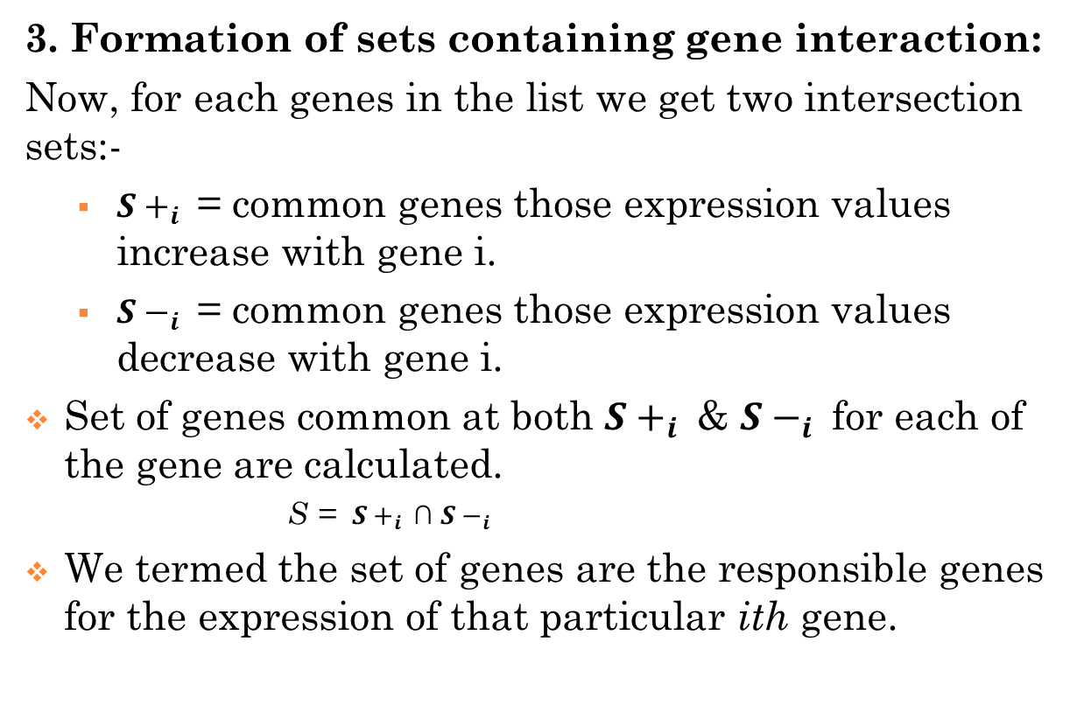
Proposed method:
3. Formation of sets containing gene interaction:
Now, for each genes in the list we get two intersection sets:-
${S+}_{i }$ = common genes those expression values increase with gene i.
${S−}_{i }$ = common genes those expression values decrease with gene i.
Set of genes common at both ${S+}_{i }$ & ${S−}_{i }$ for each of the gene are calculated.
S = ${S+}_{i }\text{∩}$ ${S−}_{i }$
We termed the set of genes are the responsible genes for the expression of that particular ith gene.

Slide 13
Proposed method:
4. Selecting most influential genes:
We calculated the weight for each gene.
Weight calculation:
Set of genes S regulated by kth gene are obtained.
For each element in S , no. of genes it regulates are calculated.
The total summation is the weight for kth gene.
Thus weight for each gene is calculated.
The average weight value is calculated.
Genes having average weight are kept and those are termed as most influential genes.

Slide 14
Proposed method:
5. Determining GRN from influential genes:
For each influential jth genes , repeating the column operation genes in the set of influential gene , we found out genes regulating it.
Using directed graph we plot the genes showing the regulatory network among the influential genes.

Slide 15
Results and analysis:
Data Reduction :
The initial dataset M(5289,47) was reduced to M+(3576,46) & M-(2804,46) after initial intersection steps.
After step 3 , we find for 2748 no. of genes with set of genes responsible for the expression of each genes.
Sample:
Gene No. | Influential gene no. | set
23 | 2 | {314,2430}
452 | 802 (max) | {1,2,9….5247,5287}
2317 | 231 | {21,57,62,…,5247}
2783 | 4 | {2405,2514,2580,2752}

Slide 16
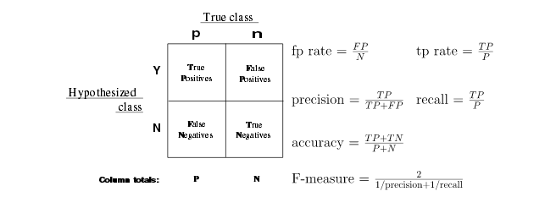

Results and analysis:
Evaluating Data using ROC curve
.Tp=
Tp=8248
Fp=231154
Fn=27862
Tn=1582850
$Accuracy=\frac{Tp+Tn}{Tp+Tn+Fp+Fn}$ =.859 or 86%(approx.)

Slide 17
Results and Analysis
After step 4, we have the genes with their weight.
We calculated the average weight ; 0.069
For GRN we considered genes above the average weight and we found out 478 genes.
Gene No. | Weight
2785 | 1
1906 | .93
4247 | .072
5011 | 0

Slide 18
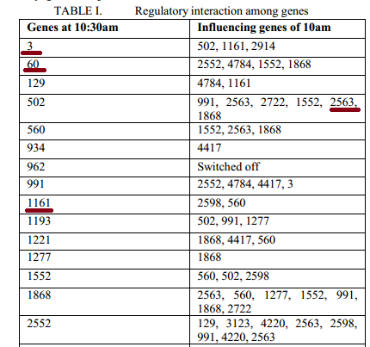
Results and Analysis
Comparative analysis between related works and proposed method:
Output obtained using
connectivity:
Output using ANR in
2 time instant
Gene | Influencing Genes
2 | 2785
18 | 10, 21,28, 57,58,….2552,1868..
934 | 18,67, 231,… 4417….
2552 | 2,10, 129, 2563,3123,…..4220..
2716 | 10,18,21,28,57…..5242,5247..
2787 | 529,1906, 2612

Slide 19
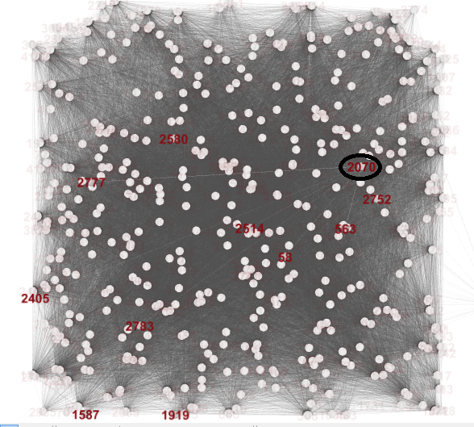
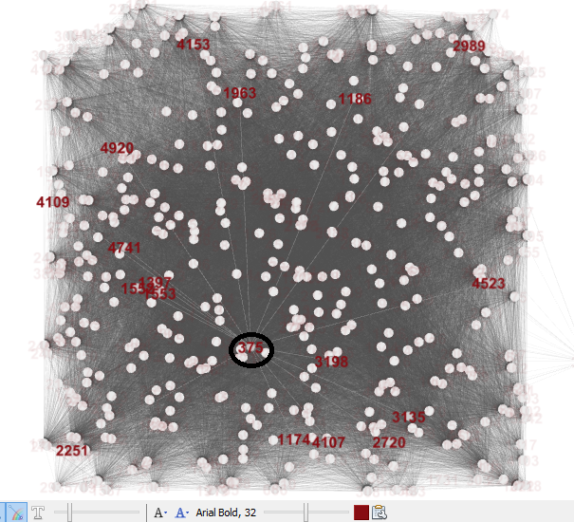
Results and Analysis:
GRN images; connectivity for Gene 2070 & 375:

Slide 20
Discussion:
Our method determines the influential genes for the expression of each gene.
Data reduction method is much optimized, with better accuracy rate.
An overall regulatory network is obtained, rather than for a particular time instant.
However, in data reduction, we discarded some genes for lower expression, which might be expressed later. Those genes might have some effect on regulation.

Slide 21
Bibliography
[1] Soumya Kanti Datta, Srirupa Dasgupta, Sounak Mitra and Dr. Goutam Saha,“Determination of Genetic Network from Micro-Array Data using Neural Network Approach” ,International Conference of Communication, Computers and Devices 2010, Kharagpur, INDIA December 10-12 ,PAPER IDENTIFICATION NUMBER: 218, 2010.
[2] M. B. Eisen, P. T. Spellman, P. O. Brown, and D. Botstein, ”Cluster analysis and display of genome – wide expression data”, Proc. Nat. Acad. Sci, 95(25): 14863 – 14868, 1998.
[3] N. Friedman, M. Linial, I. Nachman and D.Pe’er.” Using Bayesian networks to analyze expression data.” J. Comput. Biol. , 7: 601 – 620, 2000.
[4] D. Husmeier. “Reverse Engineering of genetic networks with Bayesian networks. “, Biochem. Soc. Trans., 31: 1516 – 1518, 2003.
[5] J. C. Liao et al. ,” Network component analysis: reconstruction of regulatory signals in biological systems.” , Proc. Nat. Acad. Sci., 100(26): 15522 – 15527, 2003
[6] M. K. Yeung, J. Tegner and J. Collins,” Reverse engineering genetic networks using singular value decomposition and robust regression.”, Proc. Nat. Acad. Sci., 99(9): 6163 – 6168, 2002.
[7] Sayan day and Dr. Goutam Saha, “Determination and study of Genetic Network responsible for growth of a fungus using the concepts of Baysian algorithm”. International Conference on Systems in Medicine and Biology 16-18 December 2010, liT Kharagpur, INDIA, 71-80.

Slide 22
Bibliography
[8] Joshua Stender, “Microarrays to Functional Genomics: Generation of Transcriptional Networks for Microarray experiments”, December 3, 2002, Department of Biochemistry.
[9] Patrix D’Haeseller , Shoudan Liang and Ronald Somogyi, “Genetic Network Interface: From Co-Expression Clustering to Reverse Engineering”, lecture thesis.
[10] Niranjan Baisakh and Swapan Datta, “Metabolic Pathway Engineering for Nutrition Enrichment”, chapter 19.Plant breeding, Genetics, Biochemistry division, International Rice Research Institute, Philippines.
[11] McCulloch, W.S. and Pitts, W., “A logical calculus of the ideas immanent in the nervous acitivity,” Bull. Math. Biophys., vol. 5, pp. 115 – 133, 1943.
[12] M. Minisky, and S. Papert, Perceptrons, MIT Press, Cambridge, 1988.
[13] F. Rosenblatt “The Perceptron: a perceiving and recognizing automation”, Technical Report 85-460-1, Cornell Aeronautical Laboratory, 1957.
[14] F. Rosenblatt ,“The Perceptron: a probabilistic model for information storage in the brain”, Psych. Rev., vol. 65, pp. 365-408, 1958.
[15] Hartemink et aI., "Construction of networks using Bayesian belief algorithms", Supplement 1, 18th Edition, S216-S224,2002.

Slide 23
Bibliography
[16] J. Cheng, D. A. Bell and W. Liu: "An algorithm for Bayesian Belief network construction from data", In proceedings of AI and STAT, Florida, pp. 83-90, 1997.
[17] Y. Jing, V. A. Smith, P. P. Wang, A. 1. Hartemink and E. D. Jarvis, "Using Bayesian Network inference algorithms to recover molecular Genetic regulatory networks", 12th Edition, 18 June, 2004.
[18] D. Heckerman, "A Tutorial on learning with Bayesian Networks", 1996 Technical report MSR-TR-95-06, Microsoft Research, March, 1995 (Revised November, 1996).
[19] Blagoj Ristevski,” A survey of models for inference of gene regulatory networks”, Nonlinear Analysis: Modelling and Control, 2013, Vol. 18, No. 4, 444–465.
[20] Chao Sima, Jianpong Hua ,Sungwon Jung , “Inference of gene regulatory networks using time series data : A survey”,Current Genomics, 2009,416-429.
[21] Barker NA, Myers CJ, Kuwahara H, “Learning genetic regulatory network connectivity from time series data.” IEEE/ACM Trans Comput Biol Bioinform.2011 Jan-Mar;8(1):152-65. doi: 10.1109/TCBB.2009.48.

Slide 24
Thank You

